Slide 1



Parking Management & Security System
Alwin.K.J
Adithyan Rajan
Muhammed Suhail.A.P

Slide 2
Introduction
PMM system project is developed to solve manual parking and its management worked by a security watchman and CCTV cameras. By using the PMS system the owner can fully automate the process such as monitoring vehicles, Recording individual videos & images recording, notifying the owner/admin for unauthorized entry,assigning parking lot numbers to vehicles and managing the parking, and recording data and analyzing later.

Slide 3
Features of PMS System
★ Management of parking areas
★ Surveillance of the parking area and surroundings(only if allowed in pmss)
★ Recording vehicles traffic details
★ Monitoring and analysis of parking time
★ Allocation of parking space
★ Security
★ Monitoring unauthorized vehicles entry
★ Observe activities in the parking area
★ Telegram notification to the Owner(user)
★ Broadcasting Parking lot number to the driver

Slide 4
System Requirement
Processor | intel i5 or AMD Ryzen 5
RAM | 16 GB
Storage | 500 GB hard disk space
Graphics Card | 2GB VRAM minimum
Operating System | Windows 10 or higher operating system
Network Requirement | LAN/PAN/Local-Hotspot/Local Network HUB *(PMSS must be in the same network)
Camera(Input source) | IP-Camera or any other surveillance camera with IP-Cam support in same network
Environments | Python 3.7 or above
Android Device | Android Mobile phone or Smart TV of Android version 7.0 or above

Slide 5
Hardware Components
Cameras:
The system requires cameras to capture images of vehicles. The
cameras can be IP cameras or surveillance cameras, and they must be
compatible with the system software. The camera should have a high
resolution to ensure that the license plate numbers are clear and legible.
Network:
The system requires a network connection to transfer data from
the cameras to the computer. The network should be stable and have high
bandwidth to ensure that the data transfer is fast and reliable.
Android Device:
The System requires an android smart Tv or mobile phone
to broadcast the parking lot number to the vehicle or its driver

Slide 6
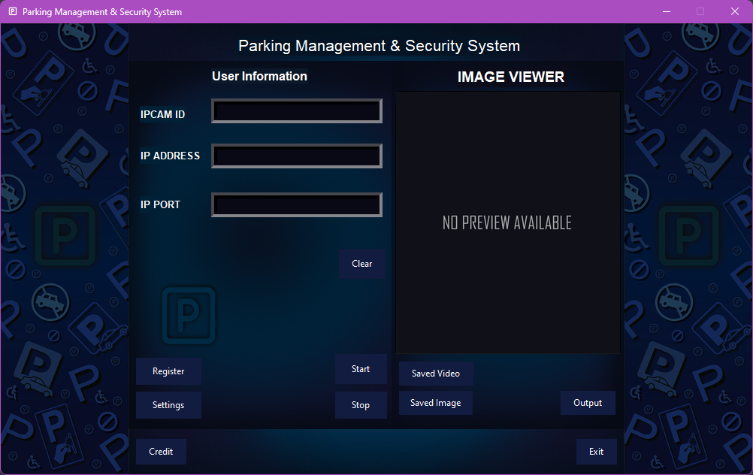
PMS SYSTEM GUI

Slide 7
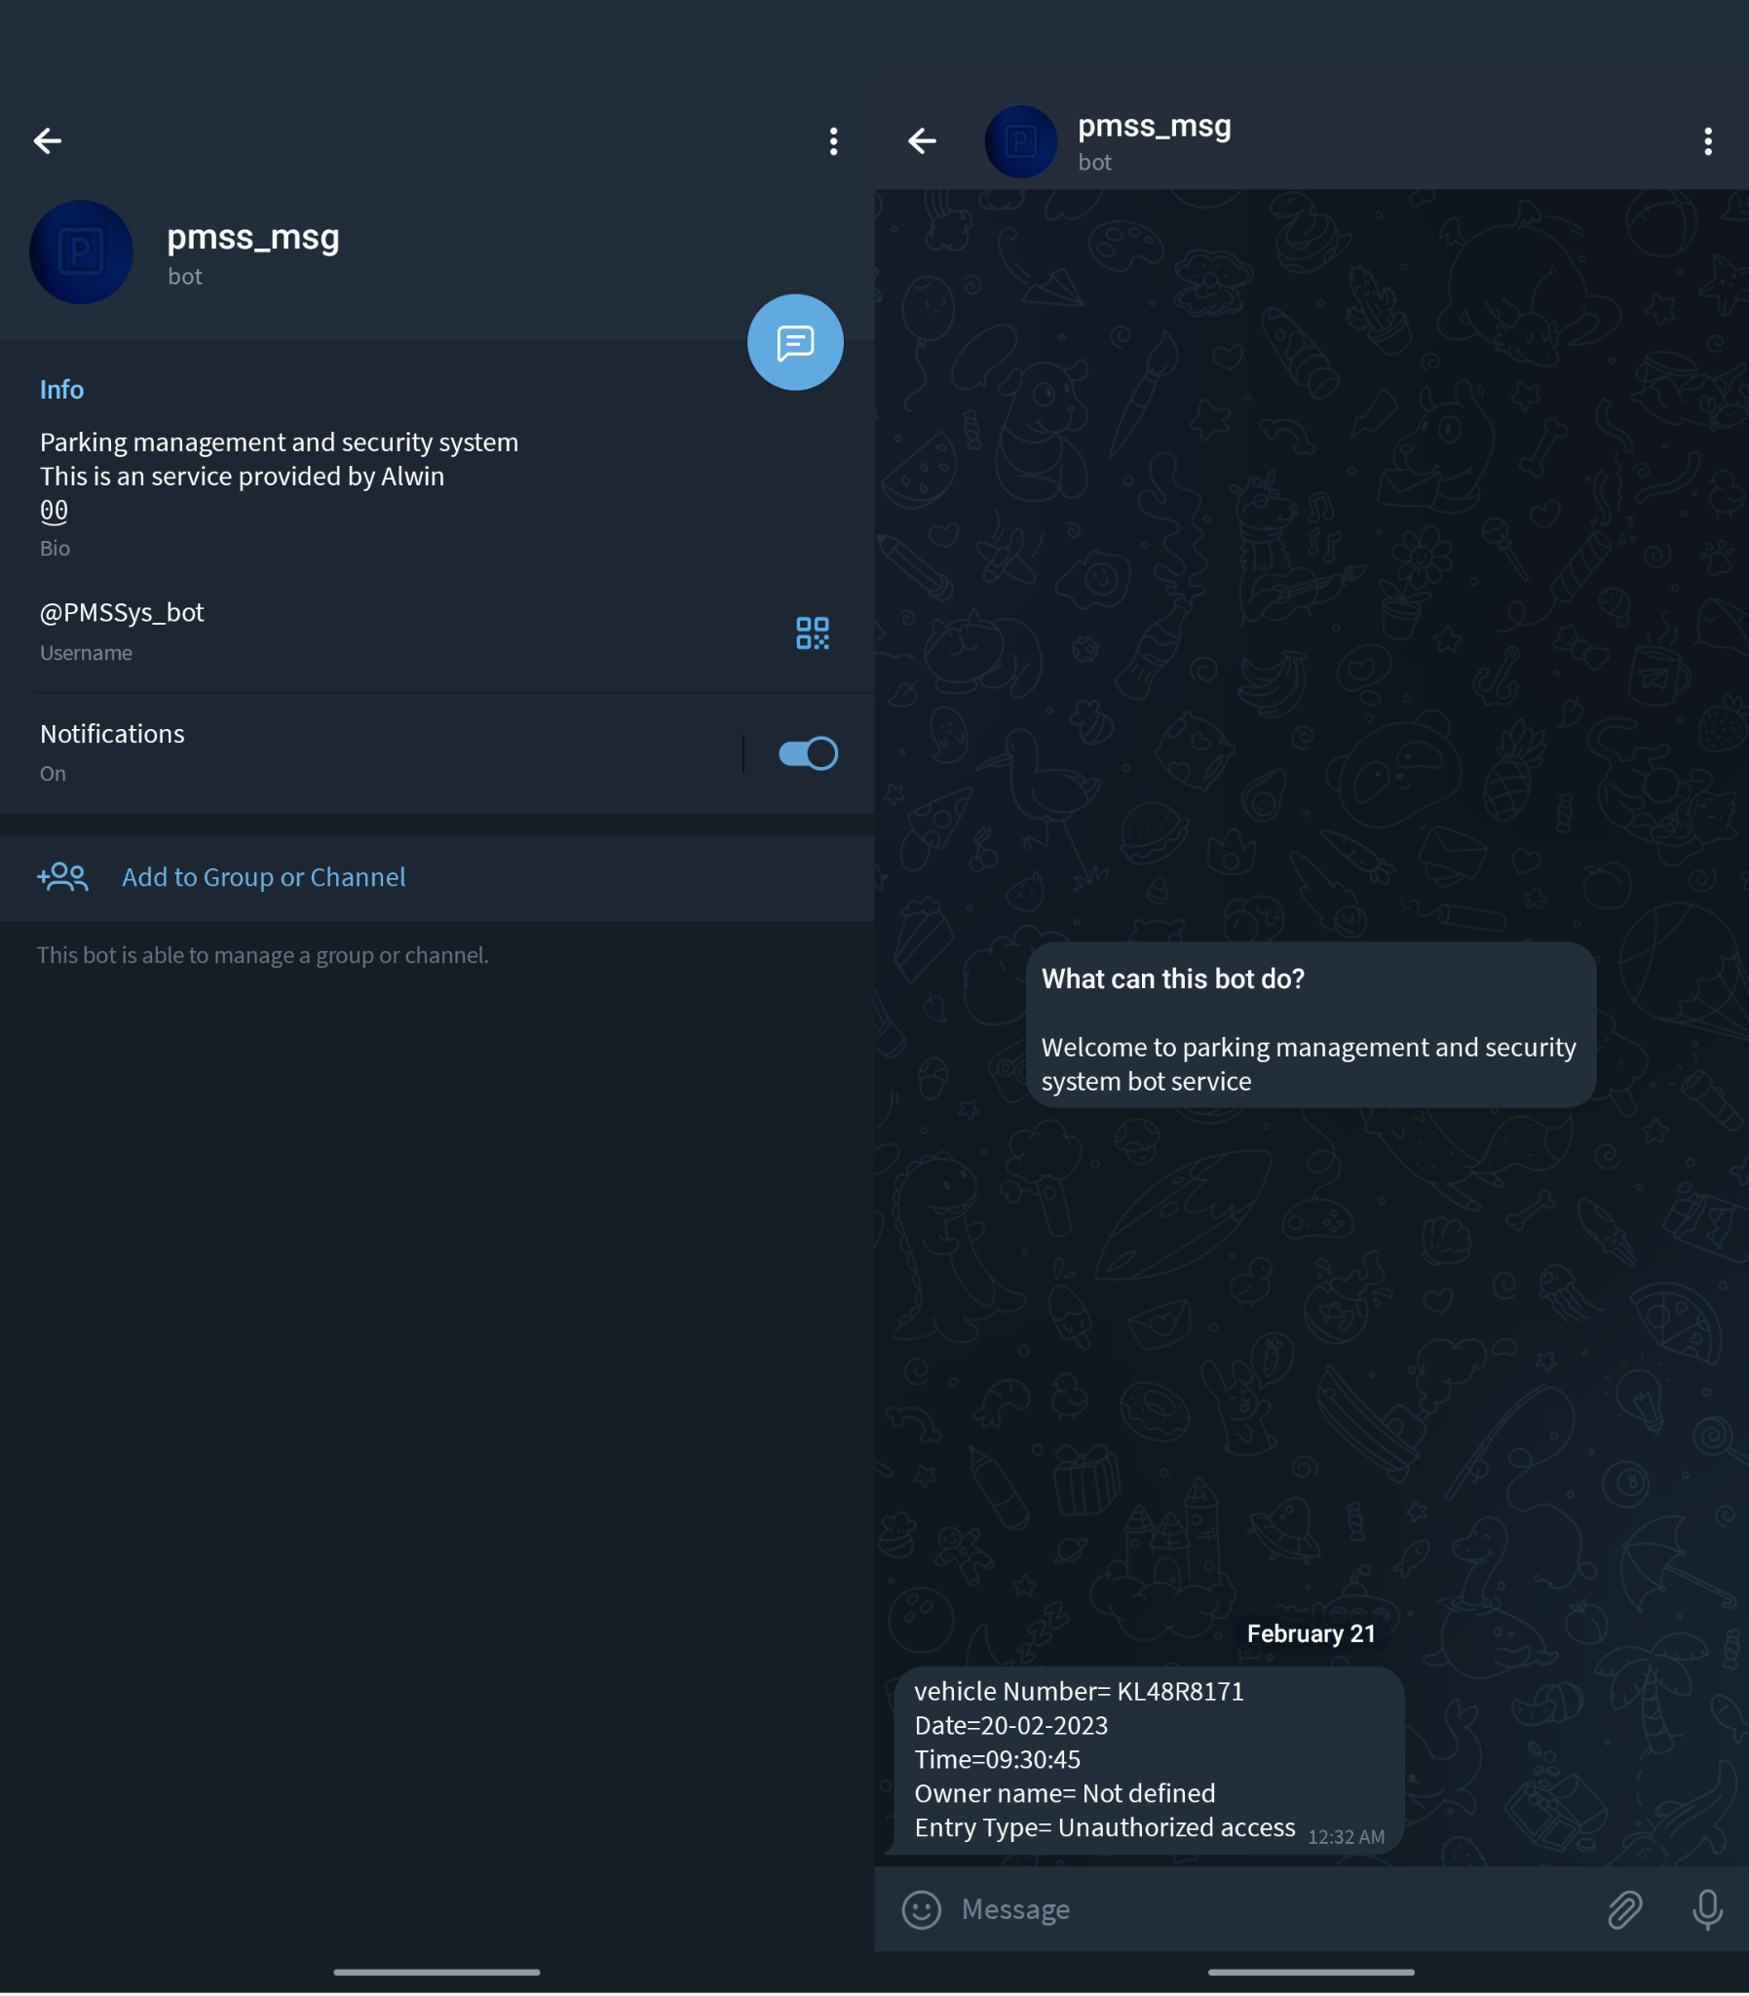
Telegram Notification

Slide 8
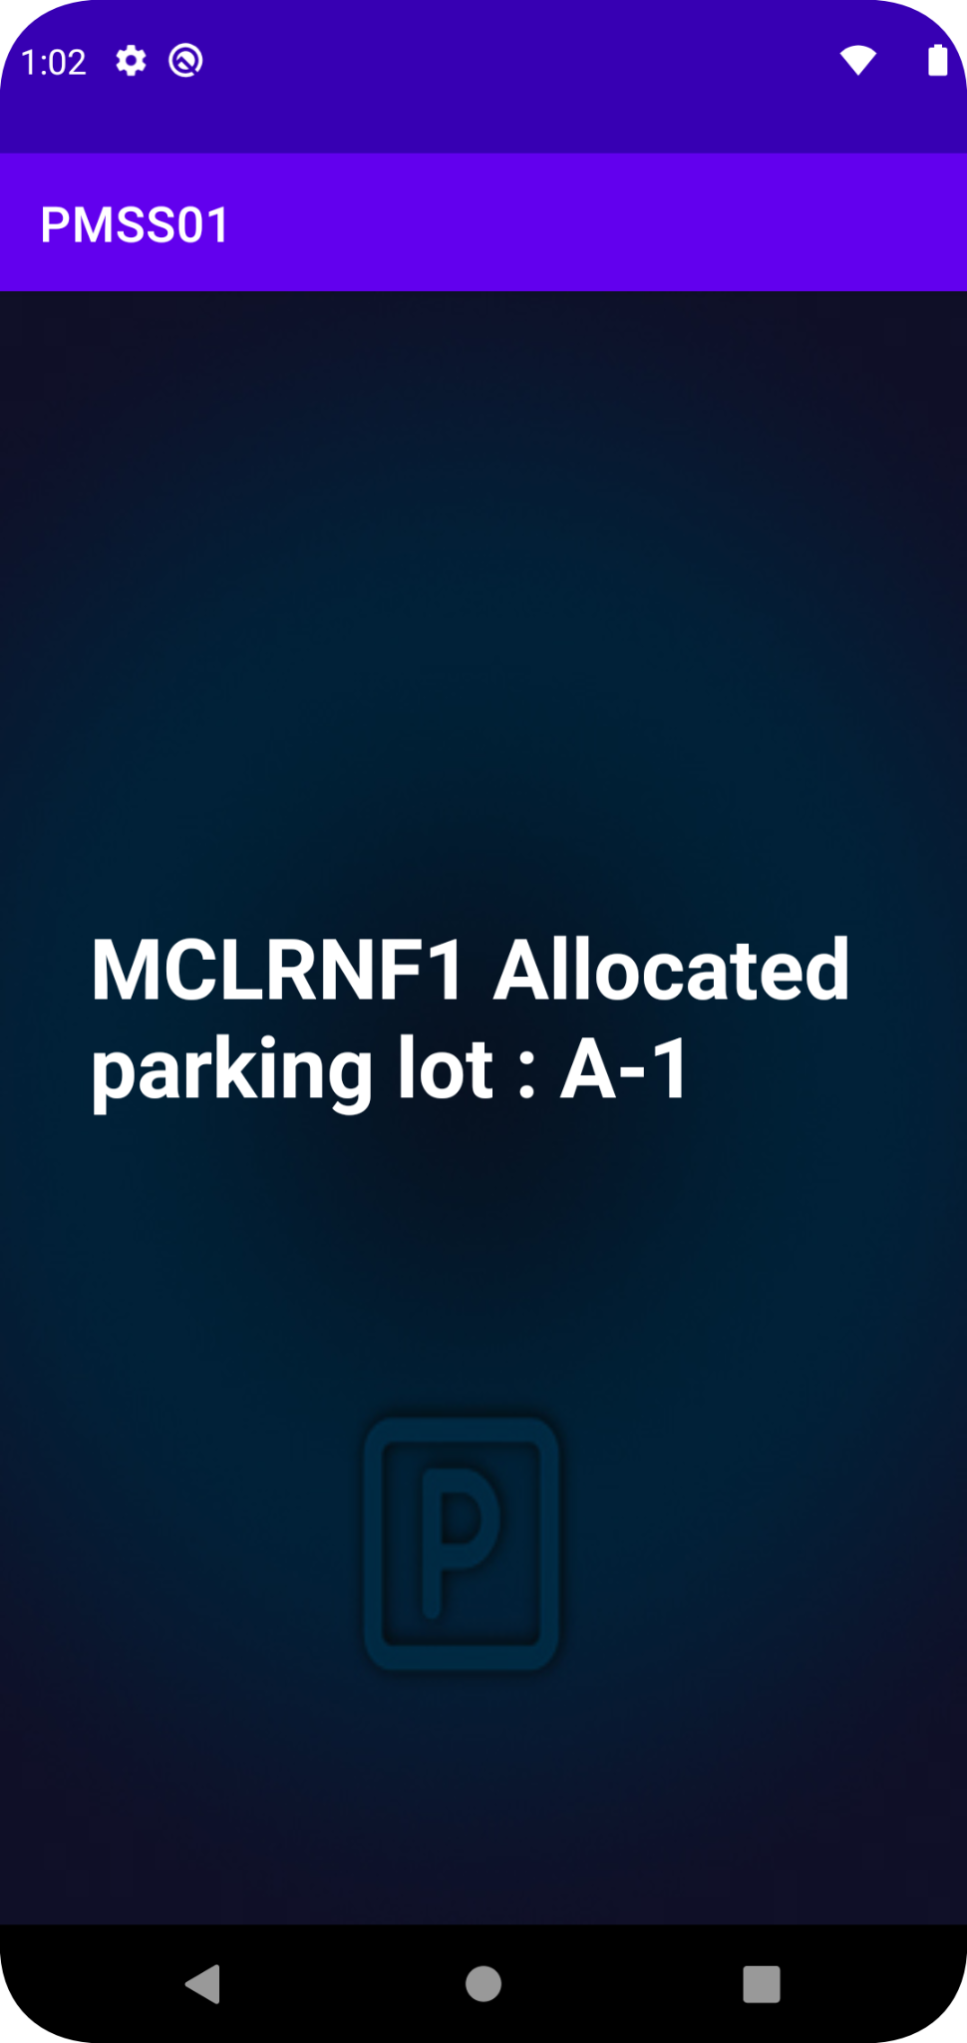
Android Broadcasting App

Slide 9
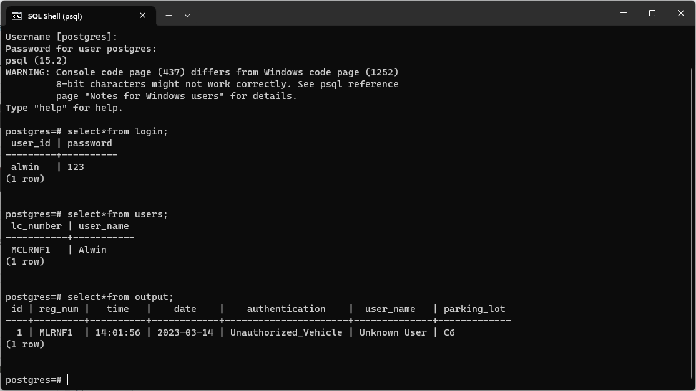
Database Storage

Slide 10
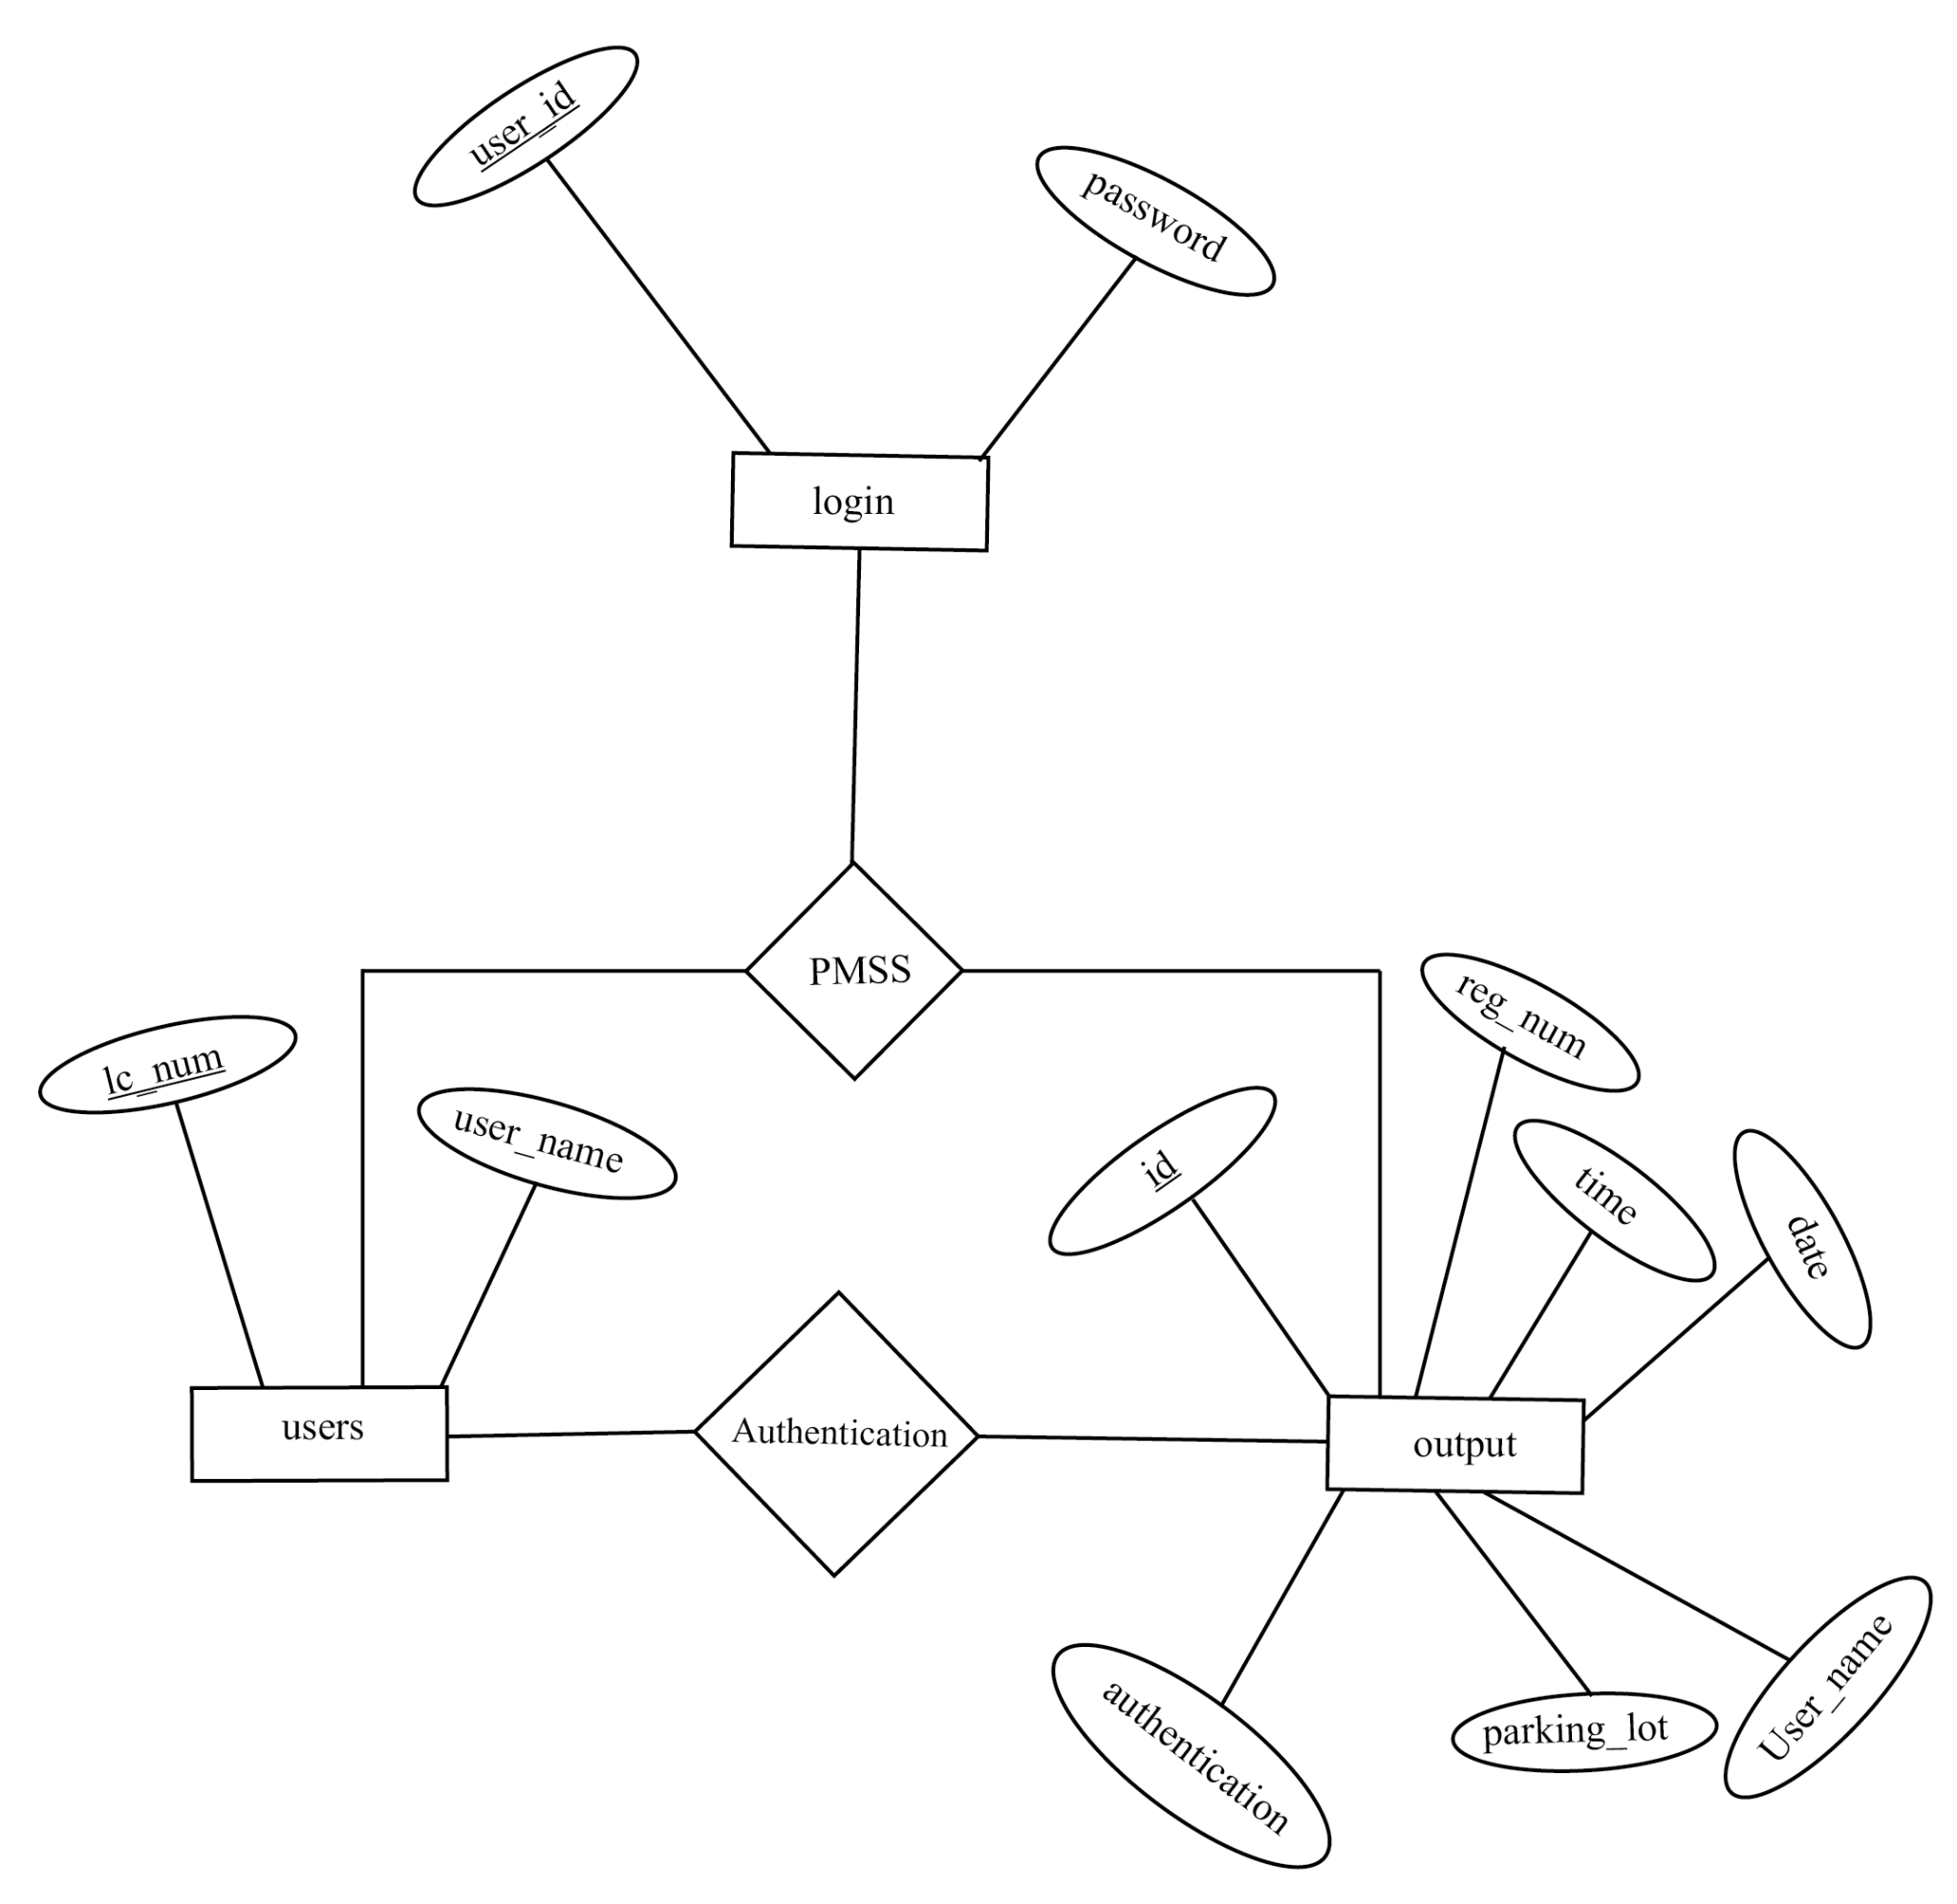
ER Diagram

Slide 11
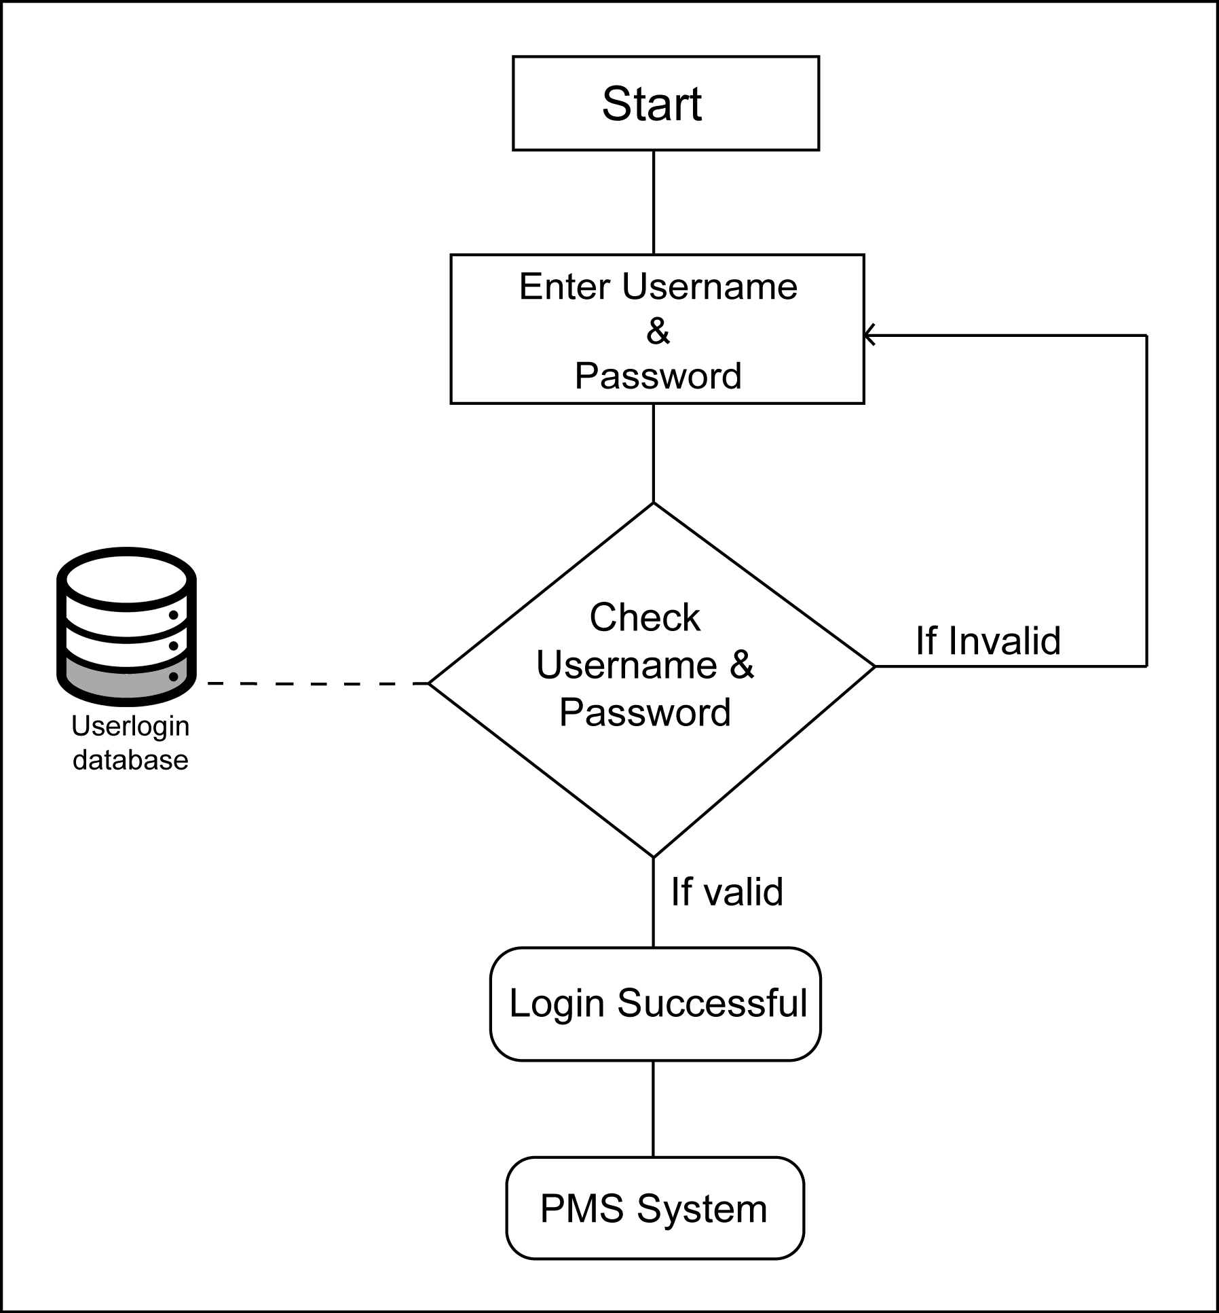
Block Diagram of User login

Slide 12
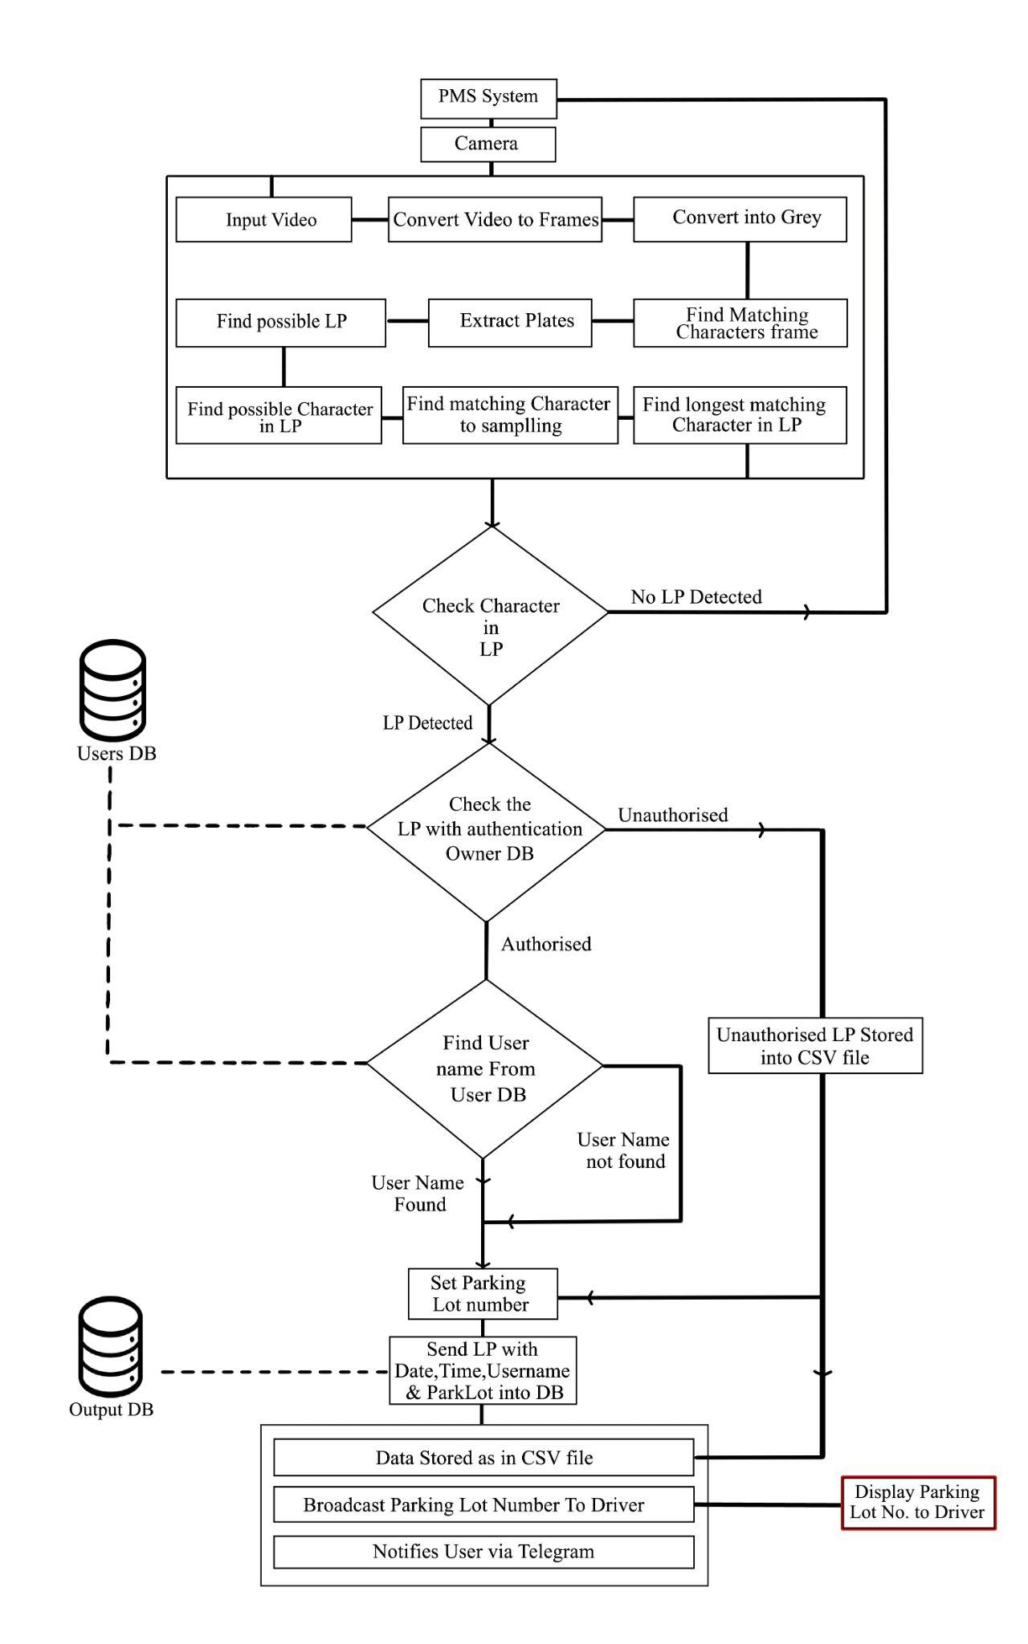
Block Diagram of PMSS

Slide 13
Number Plate Detection and Character Detection

Slide 15
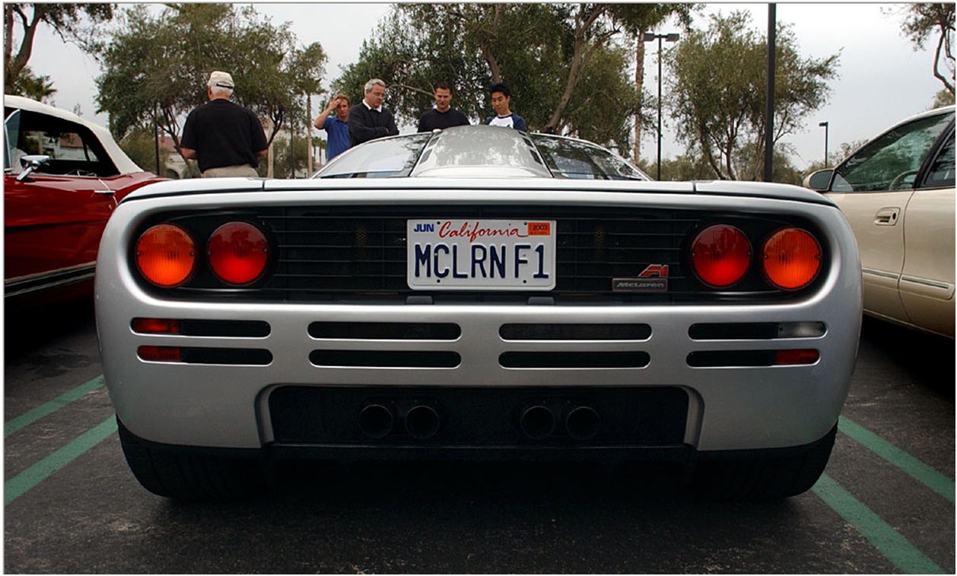
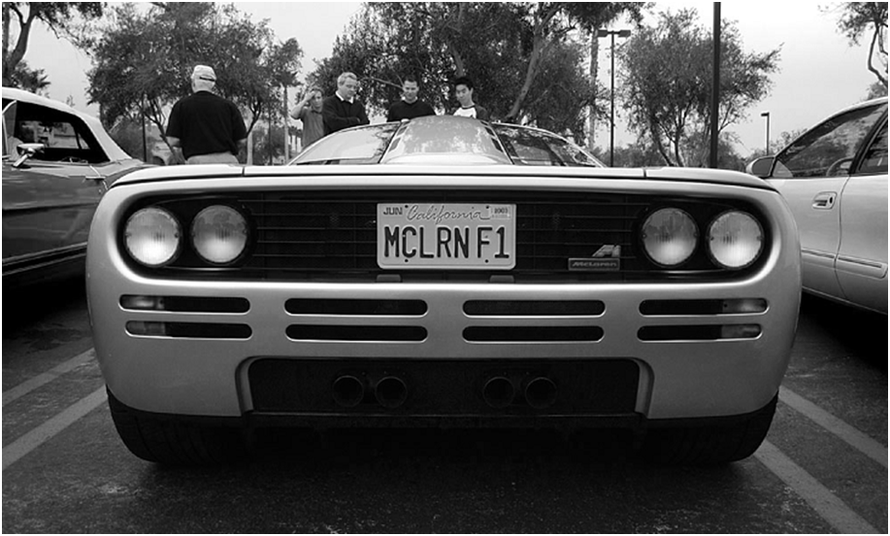
Finding Possible Number Plates
Original Image scene
Gray Scale scene of image

Slide 16
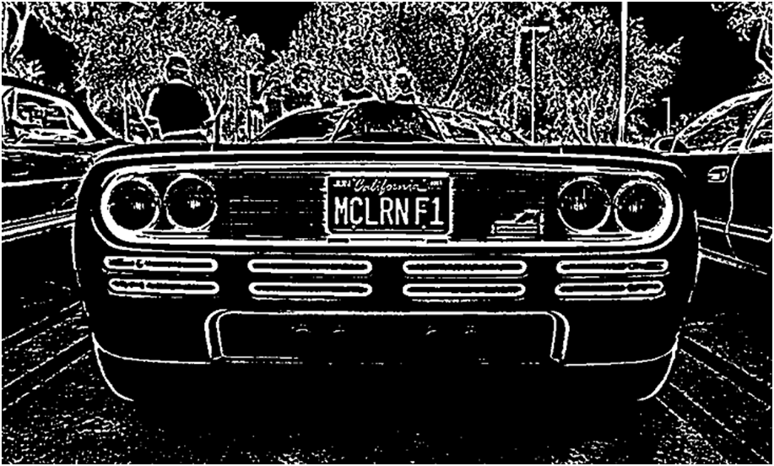
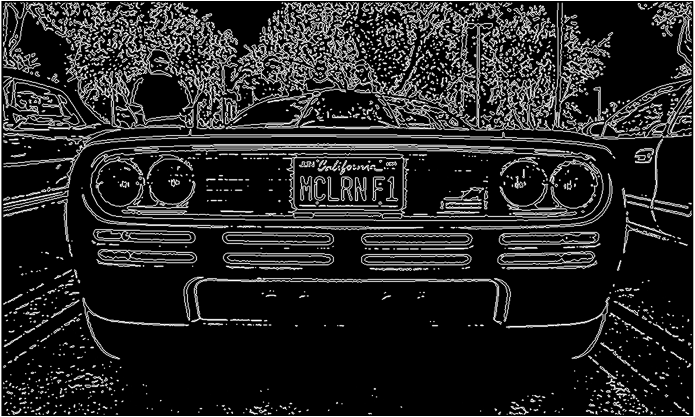
Threshold Image of the scene
Threshold Image

Slide 17
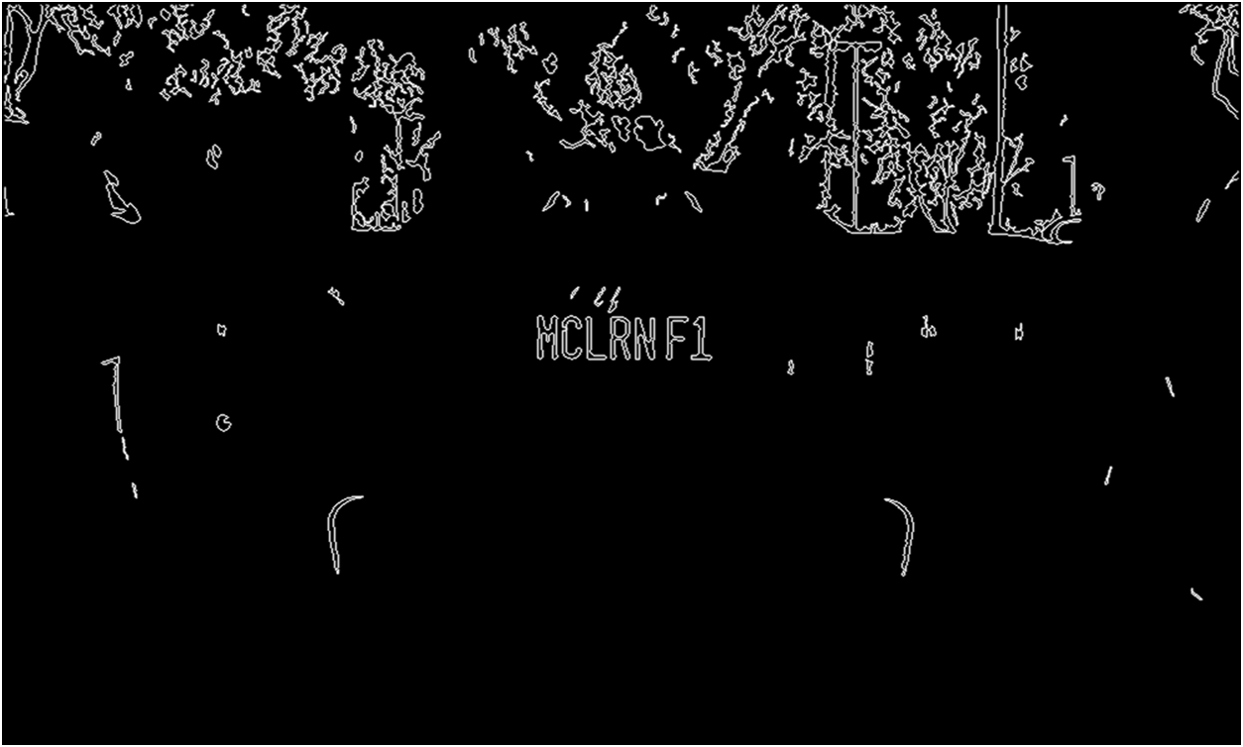
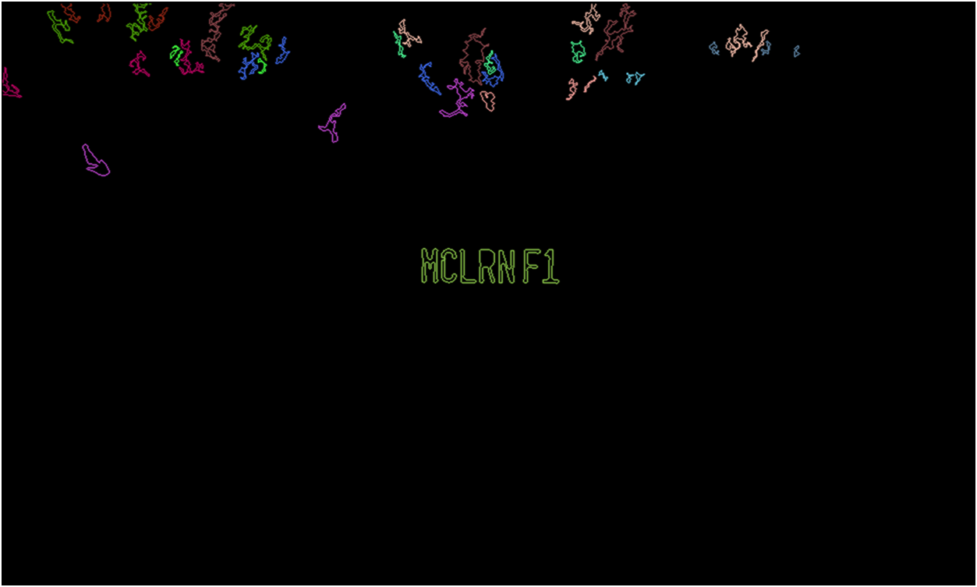
Finding Possible LP in Scene Step-1
Finding possible LP Step-2

Slide 18
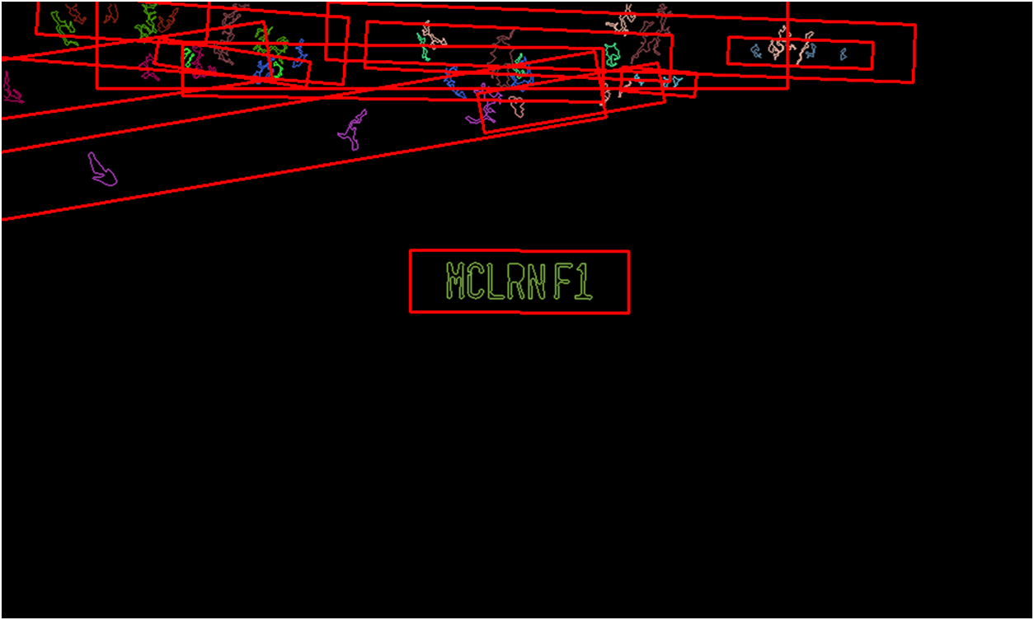
Found Possible Lp from scene
Selecting Possible LP with Characters

Slide 19
Find Possible Character String from possible Number plates

Slide 20

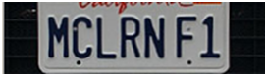
Cropping possible Number Plates from original scene
Converting Cropped Image into Threshold Image

Slide 21



Recognizing Characters from Number plate
Characters were found

Slide 22
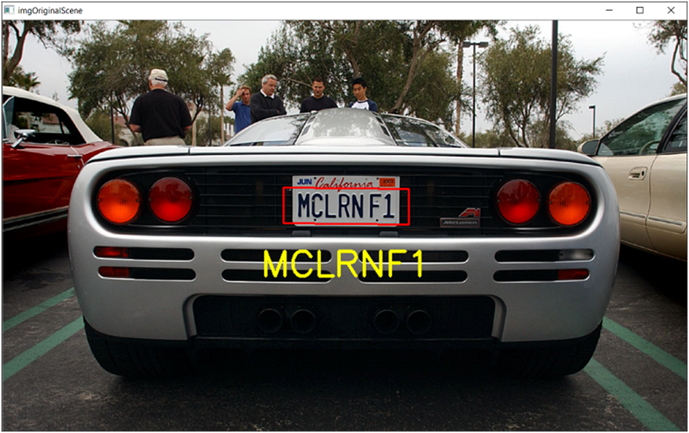
Print possible character found from original image

Slide 23
Future Updates
★ Android application will be developed
★ PMS system can be hosted in a server to increase quality and performance
★ Parking lots or slots will be added in the near future
★ Alarm System will be implemented
★ WhatsApp BOT will be introduced

Slide 24

Fin

